Slide 1

Department of Information Technology
PathPilot
AI powered career navigator
Projects under development by Atharva University
Project Members
Shravani Chirde (TE/11)
Manali Vajantri (TE/55)
Shivam Yadav (TE/67)
Neekita Suhag (TE/46)
Project Guide
Prof. Vaidehi Agrawal
Information Technology

Slide 2
CONTENT
01
02
03
04
05
06
07
08
09
10
11
INTRODUCTION
SURVEY OF LITERATURE
COMPARATIVE OVERVIEW
PROBLEM STATEMENT
GOALS AND OBJECTIVES
FLOWCHART
METHODOLOGY
TECHNICAL SPECIFICATION
APPLICATION AREAS
BUDGET
REFERENCES

Slide 3

INTRODUCTION
Pathpilot
Revolutionizing Career Guidance through Al-powered Personalized Navigation for Students at Every Educational Stage
Intelligent platform to assist students in making informed career decisions, providing customized roadmaps, college recommendations, and skill development guidance based on their educational stage and interests.

Slide 4
SURVEY OF LITERATURE
(I)
NAME OF THE PAPER | AUTHOR | PUBLISHED YEAR | SUMMARY
Design and Implementation of Higher Education Student Counseling and Career Guidance Platform Based on Big Data Technology | Hui Zhang [1] | 2025 | This paper presents a Hadoop MapReduce–based platform using the C4.5 decision tree algorithm to create detailed employment profiles and recommend career-related information for college students. The platform showed 100% pass rate. Users reported high satisfaction, particularly with career planning guidance. Overall, the platform enhances the efficiency and accuracy of employment guidance in higher education.
A study on the administration of career guidance to college students in higher education based on mental health education assessment data | Lang wang[2] | 2024 | The paper includes mental health assessment data and AI/ML models (Decision Tree, Improved K-means with double genetic algorithm) to enhance career guidance for college students. Achieves 85% accuracy in predicting employment tendencies, identifies strengths and gaps. The study also notes gender differences in employment patterns and emphasizes that integrating career guidance with mental health services can help students better adjust to the job market and enhance their competitiveness.

Slide 5
SURVEY OF LITERATURE
(II)
NAME OF THE PAPER | AUTHOR | PUBLISHED YEAR | SUMMARY
Career Path Decisions and Sustainable Options | Hamid Hassan et al[3]. | 2022 | This paper proposes a holistic model for career path planning by integrating psychological, sociological, and developmental perspectives. It emphasizes computer-assisted guidance systems to manage complex, dynamic data. The model shifts focus from single job decisions to long-term sustainable career paths tailored to individual traits, context, and growth potential.

Slide 6


COMPARATIVE OVERVIEW
PathPilot
ChatGPT
PathPilot has 3 fixed stages (After 10th, After 12th, Ongoing courses)
No predefined categories
It uses stage-specific quizzes
ChatGPT uses general knowledge.
Career, college & skill-specific datasets
It uses conversation context
PathPilot gives structured dashboards and recommendations
It just gives Text-based replies

Slide 7

PROBLEM STATEMENT
Many students in India face significant confusion and lack of proper guidance at crucial educational decision points due to limited access to personalized career counseling and information overload.
There is a pressing need for technology-driven solutions to provide stage-specific guidance, streamline college selection processes, and create personalized career roadmaps for students at different educational levels.

Slide 8
GOALS AND OBJECTIVES
Stage-Specific Guidance
Provide tailored career guidance for students after 10th, 12th, and during ongoing courses with personalized questionnaires and recommendations
Skill Development Roadmaps
Create comprehensive roadmaps for ongoing students including relevant courses, certifications, internships, and placement preparation
College & course Recommendations
Provide tailored career guidance for students after 10th, 12th, and during ongoing courses with personalized questionnaire
Career Empowerment
Reduce dependency on expensive career counseling by empowering students with Al-driven self-assessment and guidance tools

Slide 9
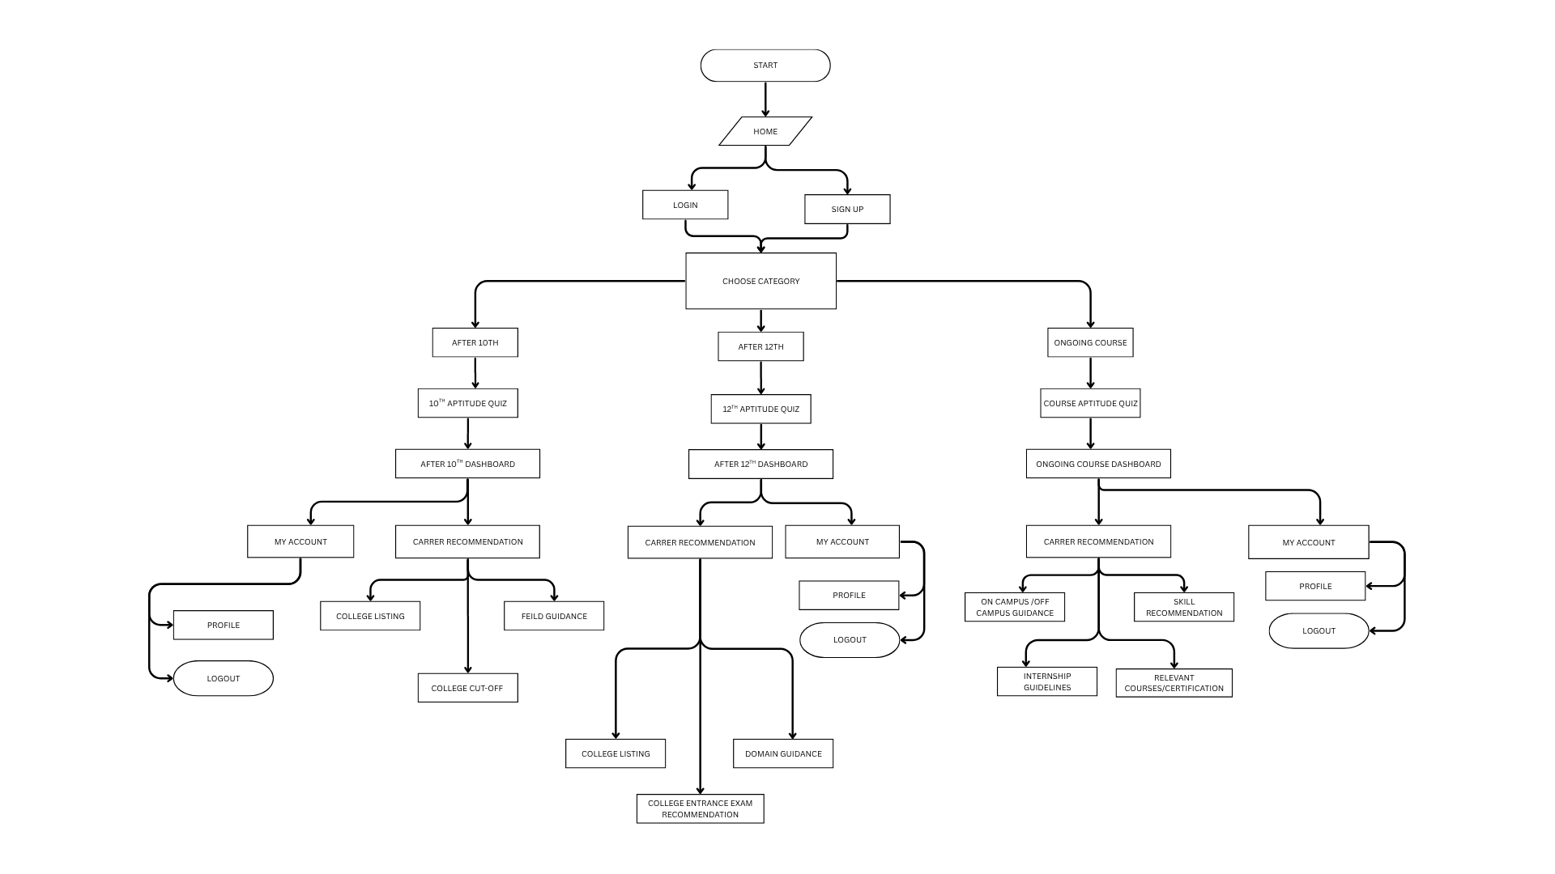
FLOWCHART

Slide 10
METHODOLOGY
1-3 Week
4-6 Week
7-10 Week
11-12 Week
01
02
03
04
RESEARCH & PLANNING
DATA COLLECTION & DATABASE DESIGN
DEVELOPMENT & AI INTEGRATION
TESTING & DEPLOYMENT
Develop web application using HTML and Tailwind CSS, integrate Al models for personalized recommendations and assessments
Comprehensive testing with different user categories, performance optimization, and deployment with user feedback integration
Analyze Indian education system, conduct user research, and design system architecture for different student categories
Gather college data, exam information, career paths, and design comprehensive database schema for all educational stages

Slide 11





TECHNICAL SPECIFICATIONS
Creates the structure of the Pathpilot AI web pages.
Stores user data, answers to the quiz, and roadmap specification .
Helps to generate roadways based on students answer. (Aptitude Quiz)
Used to build the AI logic and backend of PathPilot
the REST API connects the frontend and backend to exchange data.

Slide 12

APPLICATION AREAS
Post- 10th Students: Stream selection guidance (Science, Commerce, Arts), diploma recommendation and state-wise college listing.
Post- 12th Students: College recommendations, entrance exam guidance, cutoff analysis and preparation strategies.
Ongoing Course Students: Skill development roadmaps, certification guidance, internship opportunities, and placement preparation
Profile Building & Dashboard: Personal development tracking, progress monitoring, and career milestone management

Slide 13
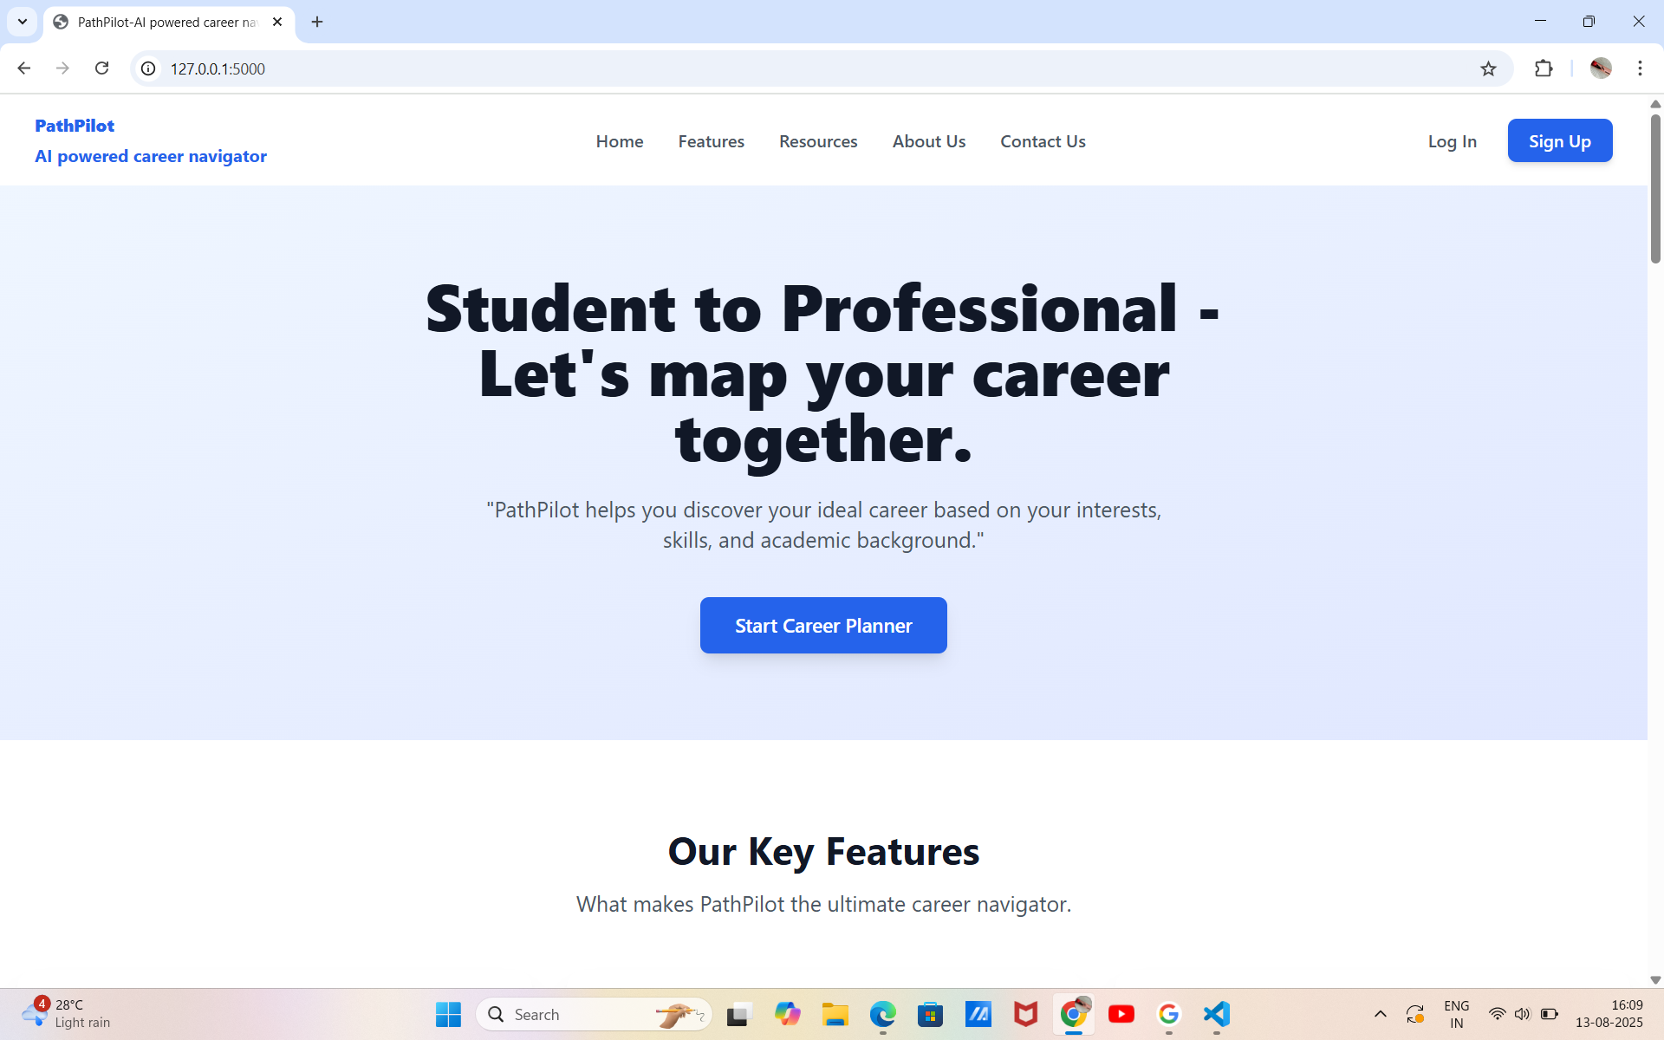

Slide 14
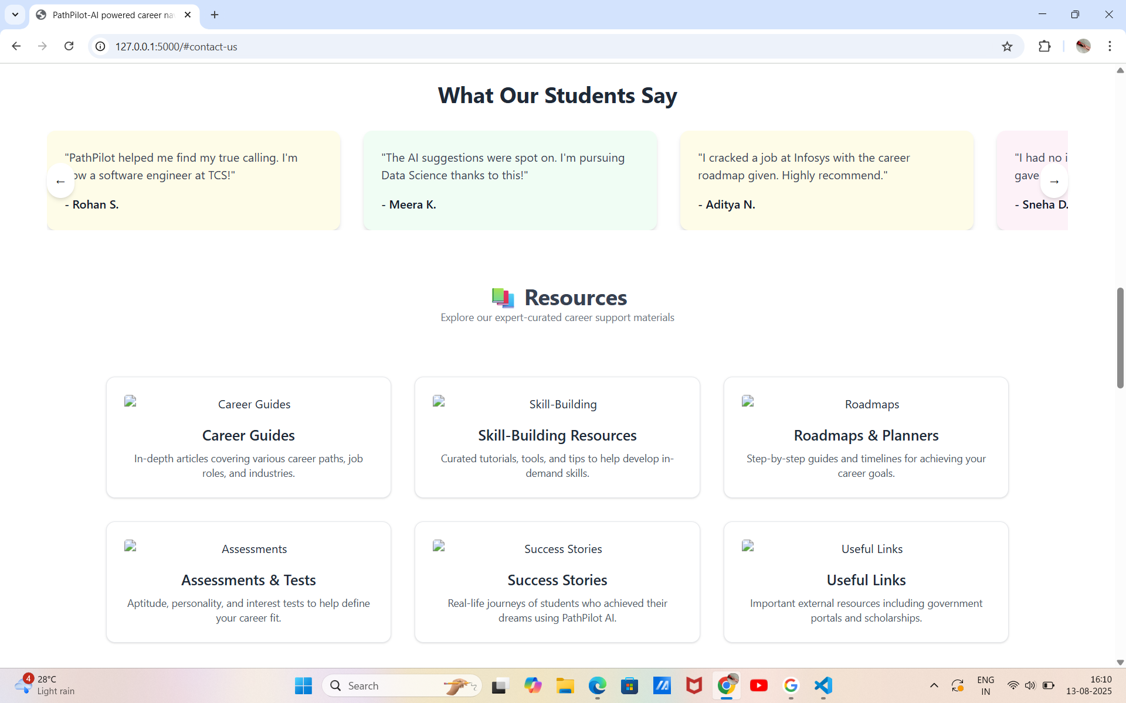

Slide 15
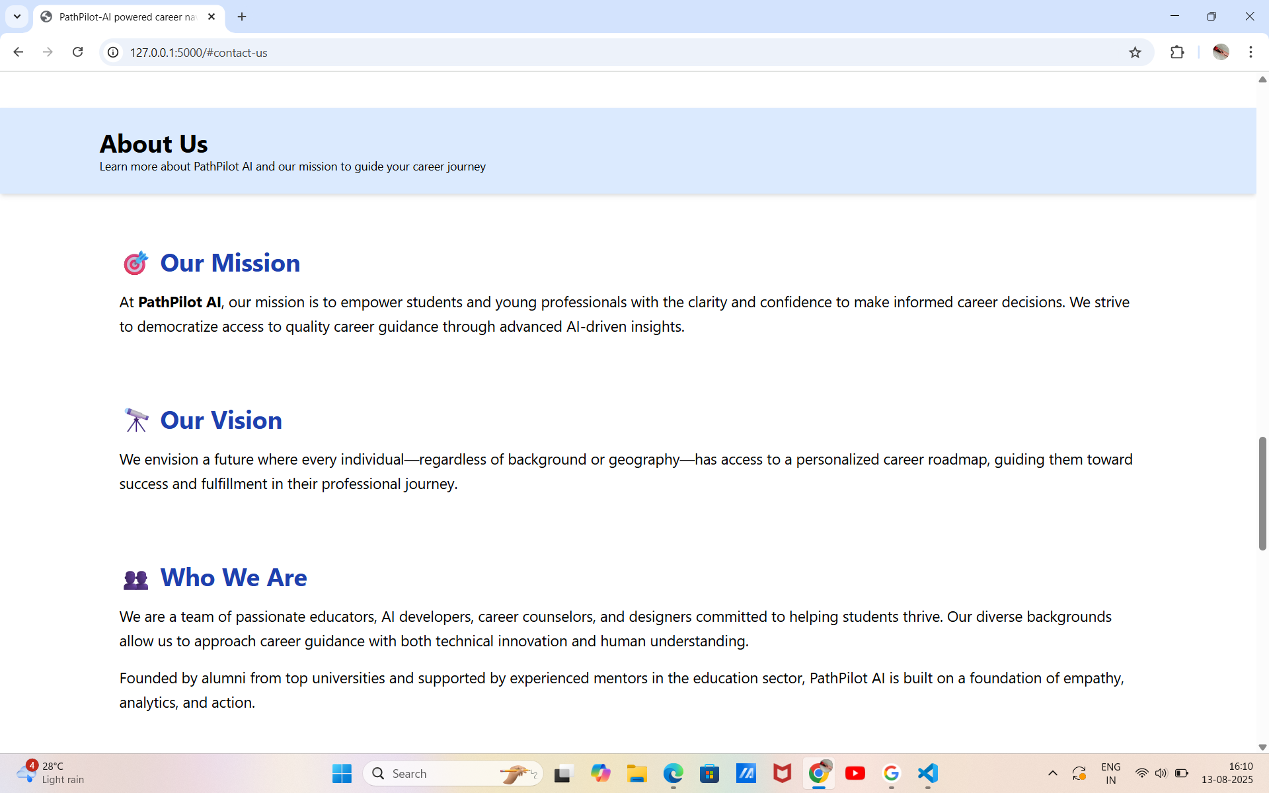

Slide 16
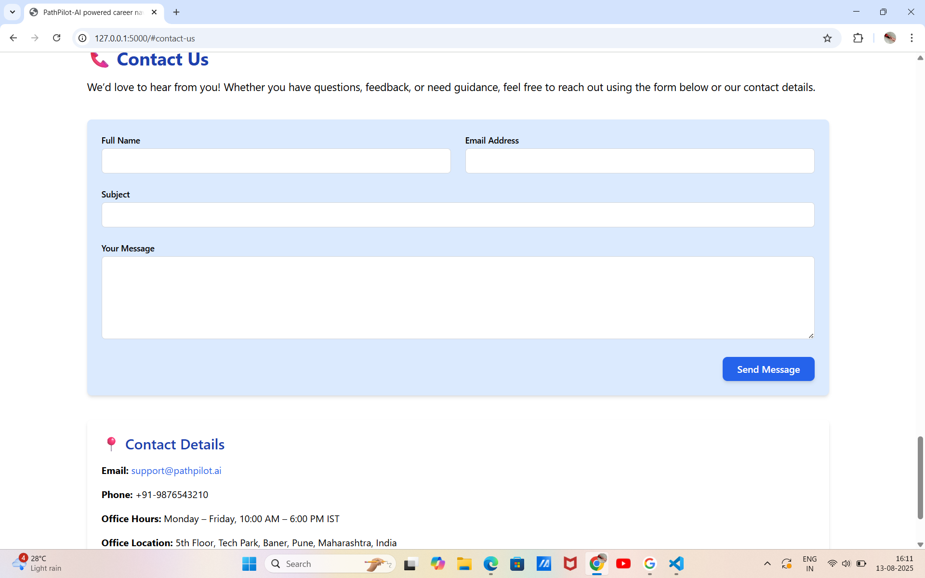

Slide 17
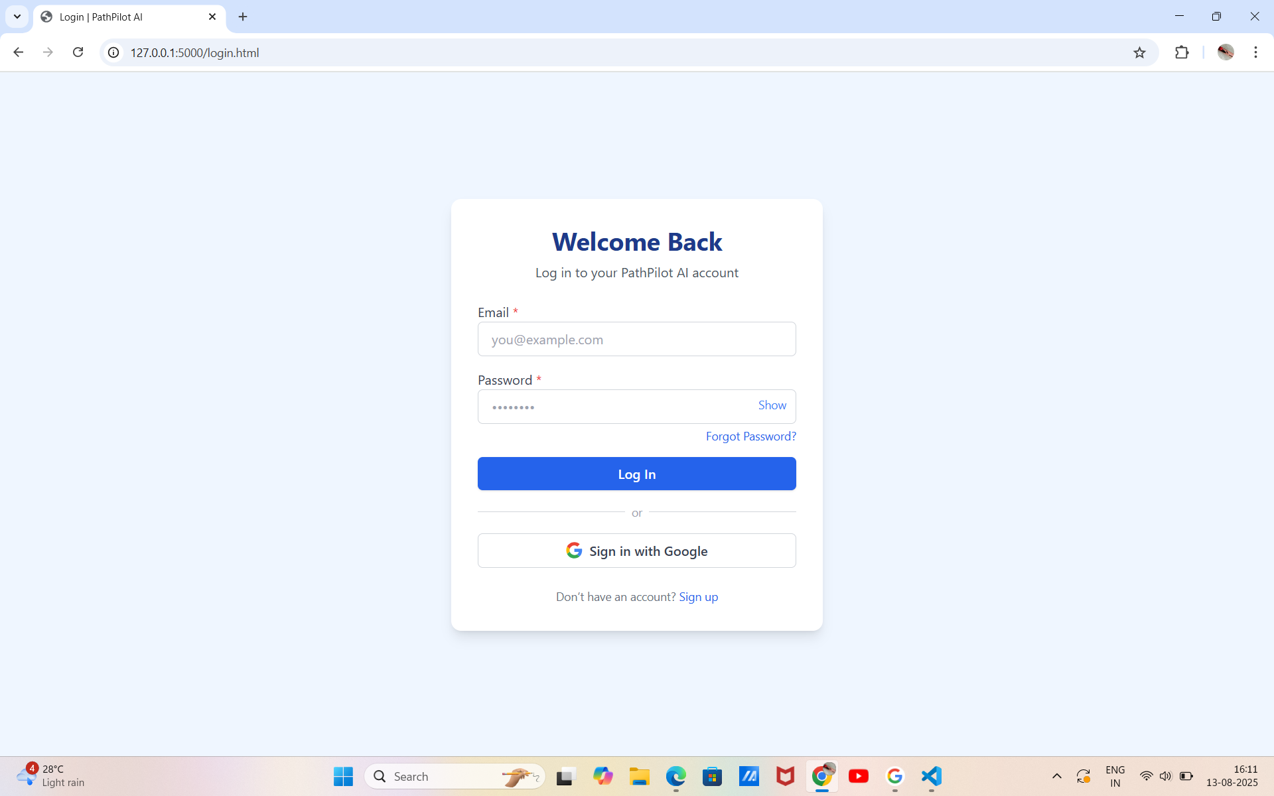

Slide 18
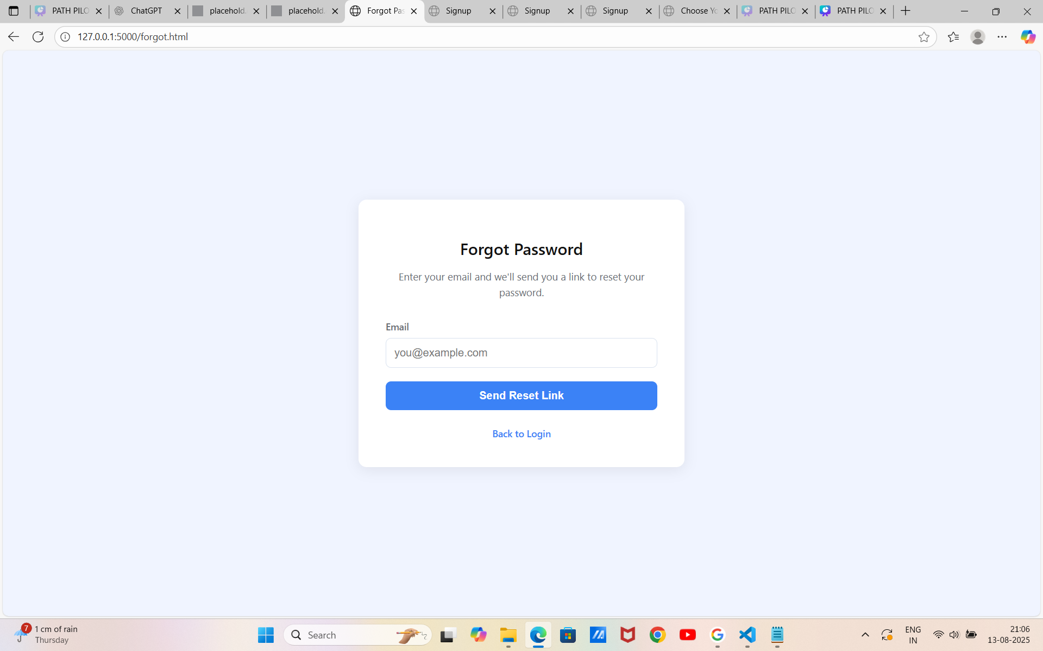

Slide 19
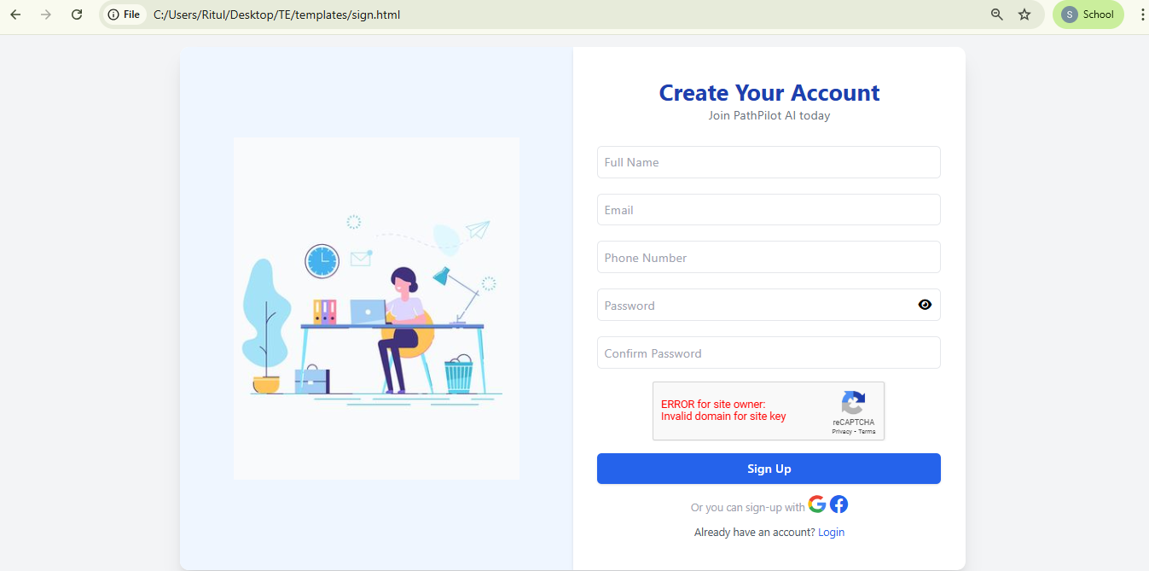

Slide 20
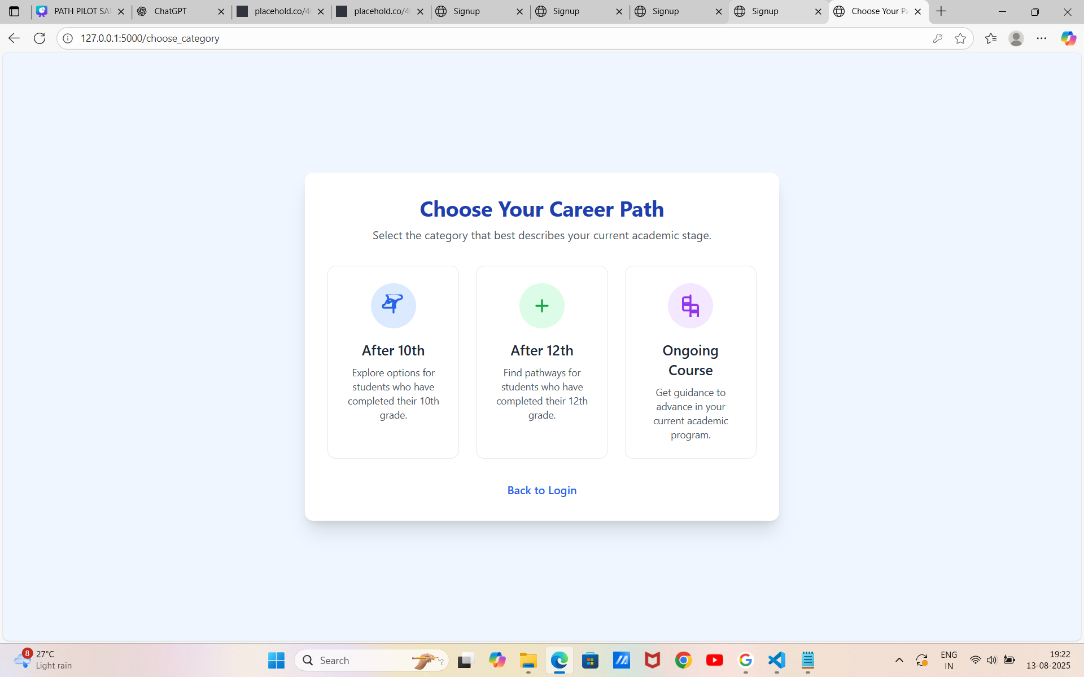

Slide 21
BUDGET
CATEGORY | BUDGET
DOMAIN NAME | 15,000
SSL CERTIFICATE | 3,000
CLOUD | 3,000
HOSTING | 3,000
SUBSCRIPTION/PREMIUM | 5,000
ADVERTISMENT | 2,000
TOTAL | 31,000/-

Slide 22
REFERENCES
[1] H. Zhang, "Design and Implementation of Higher Education Student Counseling and Career Guidance Platform Based on Big Data Technology," 2025.
[2] Lang Wang. A study on the administration of career guidance to college students in higher education based on mental health education assessment data. Applied Mathematics and Nonlinear Sciences, Vol. 9, Issue 1 (2024), pp. 1–13. Published Online: February 26, 2024.
[3] Hassan, H., Hussain, M., Niazi, A., Hoshino, Y., Azam, A., & Kazmi, A. S. (2022). Career path decisions and sustainable options. Sustainability, 14(17), 10501

Slide 23
THANK YOU!

